Slide 1
Data211 FINAL PROJECT
Natalie Klang

Slide 2
DESCRIPTION
I collected data for 2+ weeks on our 10-month-old dog, Kiki.
My husband and I logged on a whiteboard every time we took Kiki outside or cleaned up an accident.
I entered data into Excel manually from daily photos taken of the whiteboard.

Slide 3
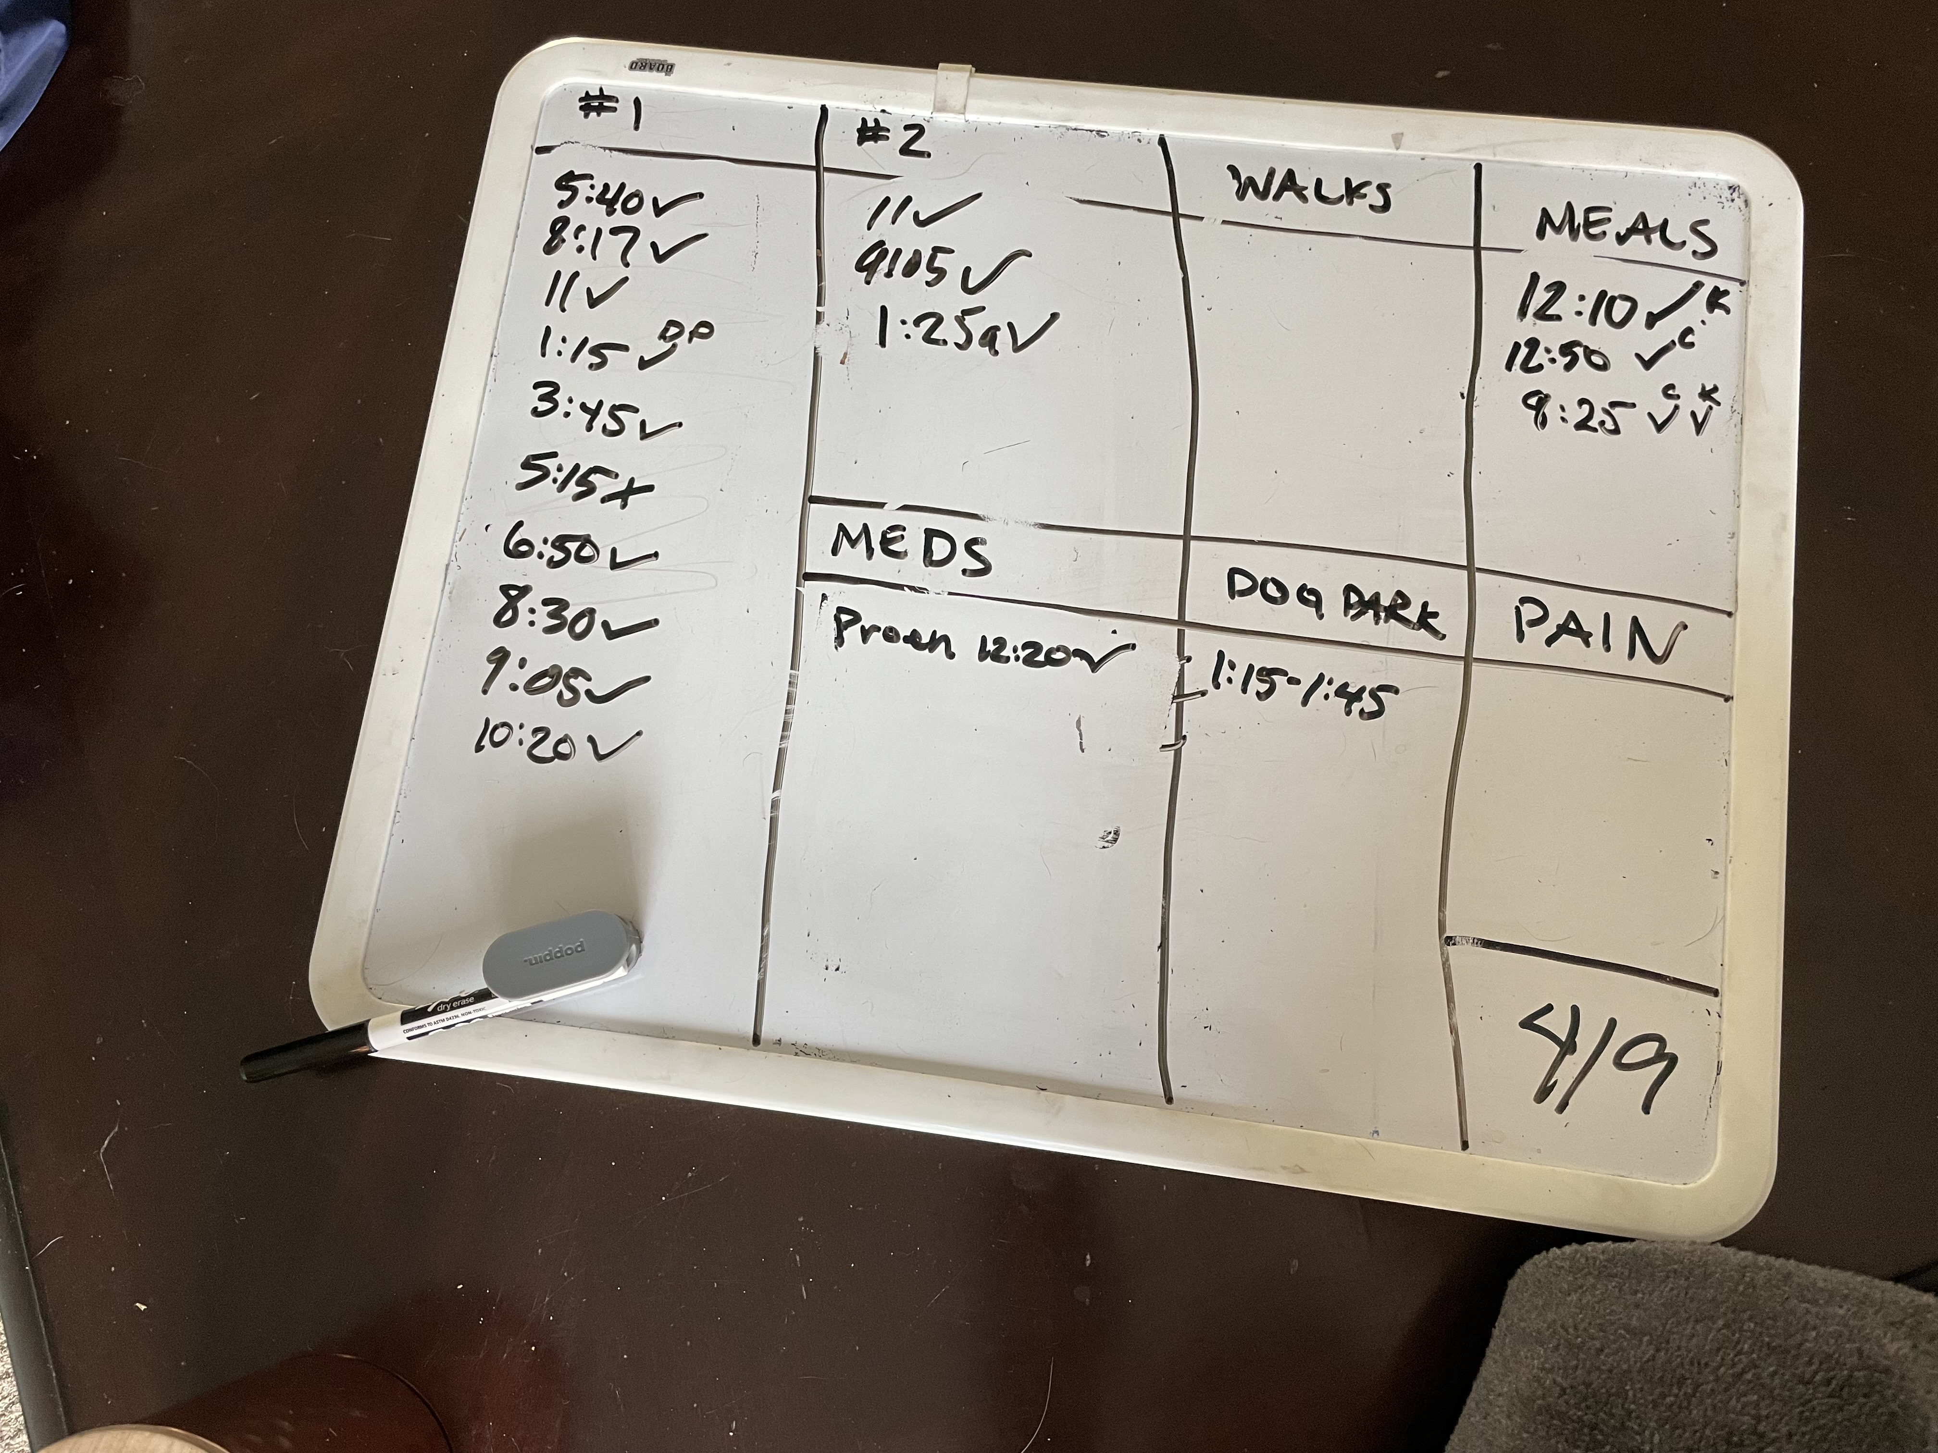
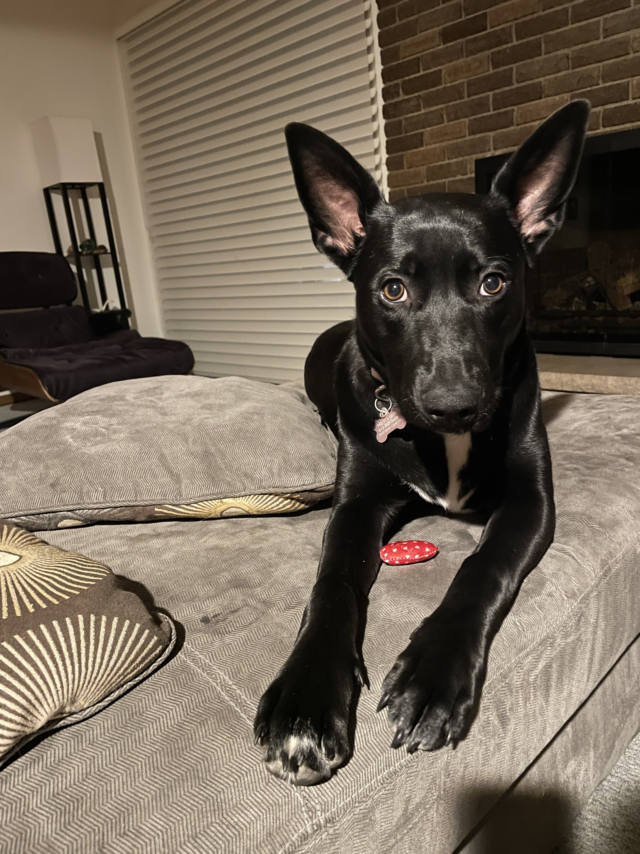

Slide 4
exploration
Do I take Kiki outside significantly more than my husband does?
Consider the total population to be the total number of times my husband and I have ever taken the dog outside.
For this exploration, I considered a sample of 17 days.

Slide 5
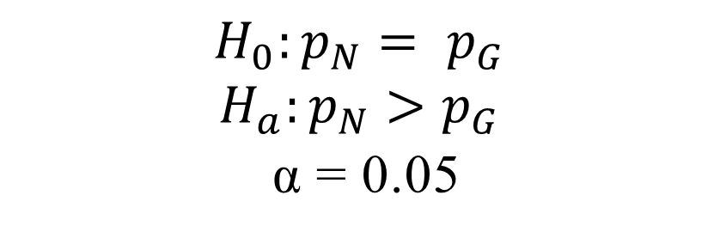
HYPOTHESIS
$$H_{0}:p_{N}= p_{G}$$
$$H_{a}:p_{N}>p_{G}$$
α = 0.05

Slide 6
DATA WRANGLING
Because of how I collected and entered data into Excel, I need to do some data wrangling first before I can perform my hypothesis test.

Slide 7
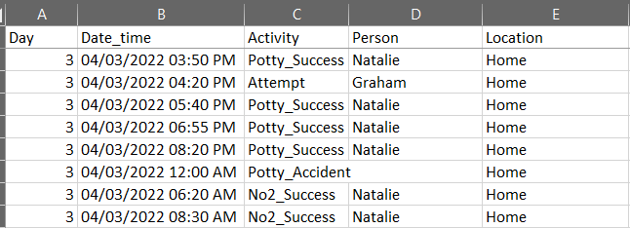
Excel format
Data entered in long format. One activity for every line item.
Data is also entirely categorical. I need to perform counts across the various activities and summarize in a table.

Slide 8
DATA WRANGLING IN R
I used the following functions to wrangle the data into more workable formats:
arrange()
filter()
select()
mutate()
summarize()
group_by()
spread()

Slide 9
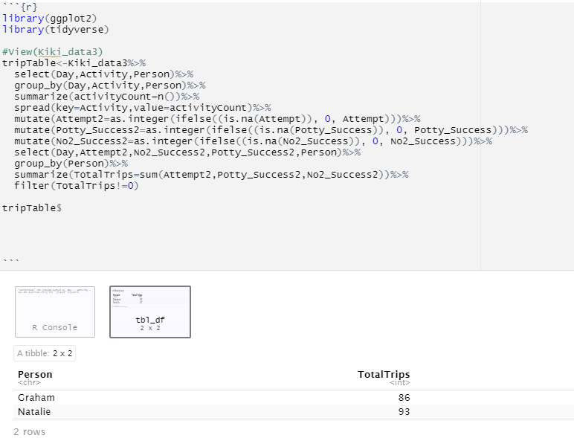
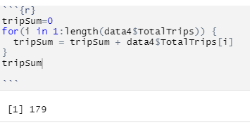
DATA WRANGLING IN R (contd)

Slide 10
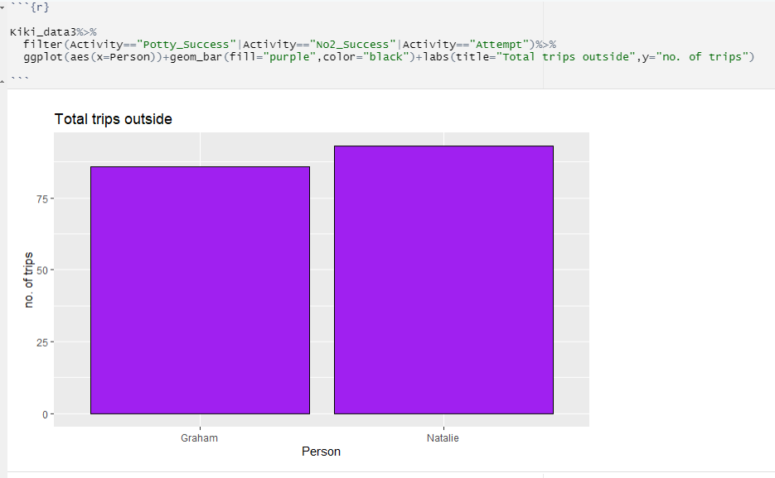
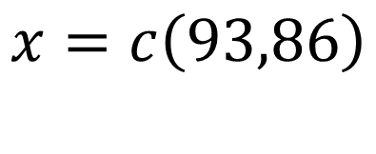
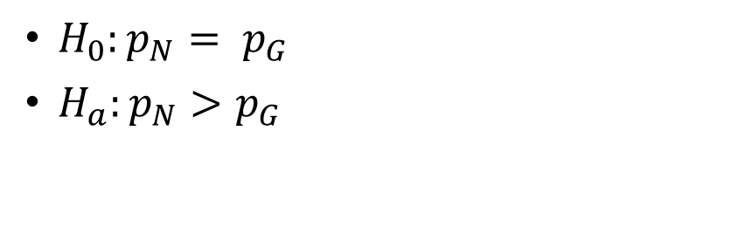
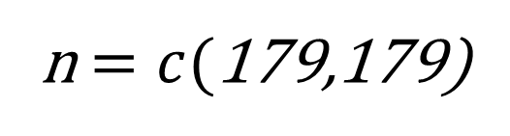
HYPOTHESIS TEST
$H_{0}:p_{N}= p_{G}$
$H_{a}:p_{N}>p_{G}$
$$x=c\left(93,86\right)$$
n $=c($179,179)
DATA211
10

Slide 11
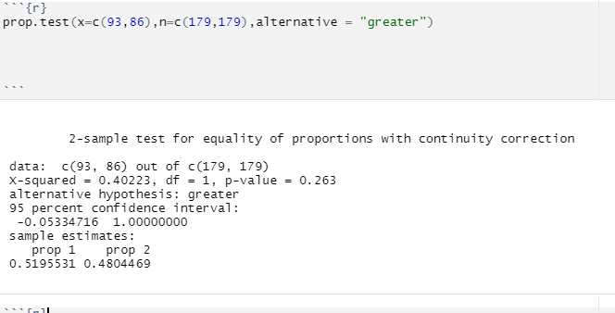
result

Slide 12
Question 1 conclusion
Since the p-value (0.263) is greater than α, there is not evidence to support the claim that I take Kiki outside significantly more than my husband.

Slide 13
RE-FRAMING THE question…
Do I take the dog outside significantly more than my husband does when we are both at home?
Consider the total population to now be the total number of times my husband and I have ever taken the dog outside when we are both at home together.
Exclude any trips outside in which the other person wasn’t home.

Slide 14
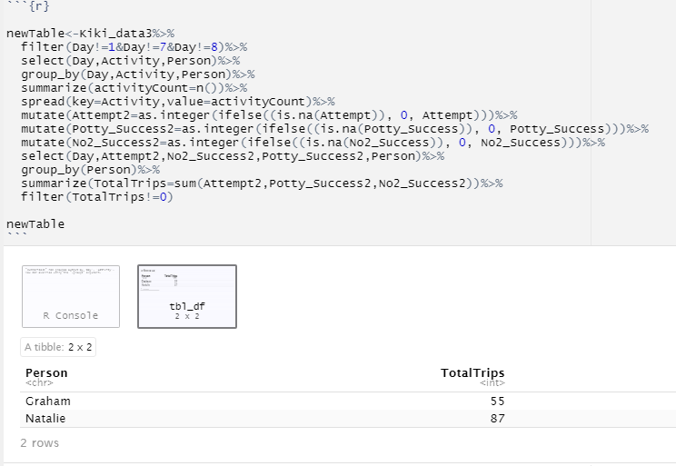
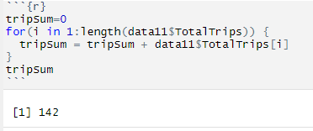
REVISED DATASET

Slide 15
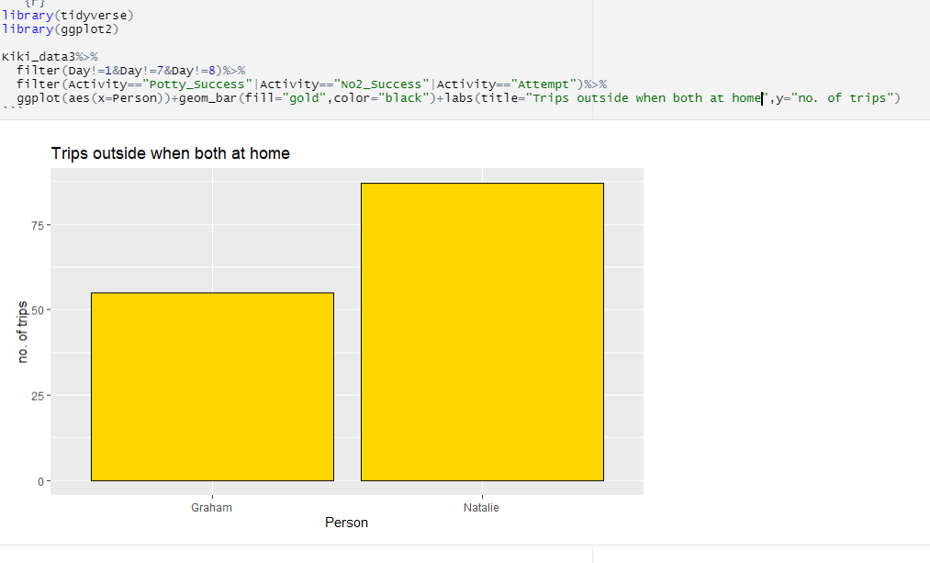
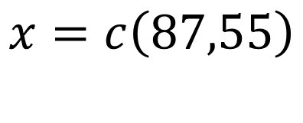
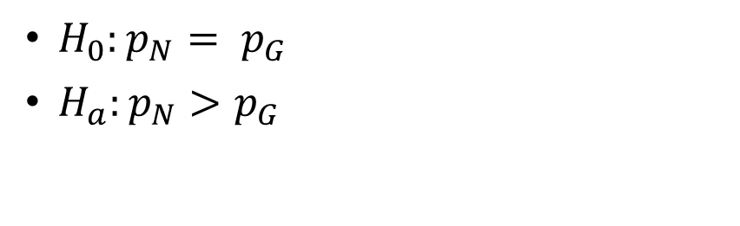
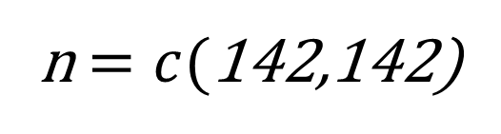
REVISED HYPOTHESIS TEST
$H_{0}:p_{N}= p_{G}$
$H_{a}:p_{N}>p_{G}$
$$x=c\left(87,55\right)$$
n $=c($142,142)
DATA211
15

Slide 16
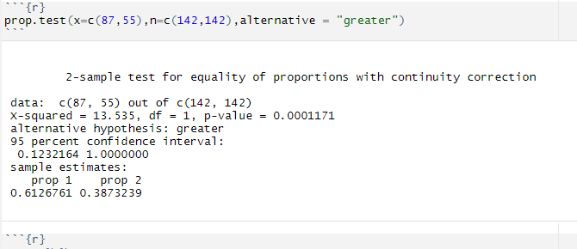
REVISED result

Slide 17
Question 2 conclusion
Since the p-value (0.0001171) is smaller than α, there is evidence to support the claim that I take Kiki outside significantly more than my husband when we are both at home.

Slide 18
QUESTIONS?

